Slide 1
Open authoring: Content collaboration across disciplines
Ralph Squillace
Senior (means “old”) Content Engineer (What?)
Microsoft Cloud + Enterprise (must be large)

Slide 2
Key takeaways
Collaboration across disciplines drives customer satisfaction
Open authoring strategies and tools that allow active collaboration across engineering, consulting, architecture, and support teams
Challenges of open authoring and cross-discipline content accountability
Best practices for sustainable collaboration

Slide 3
Kliff’s™ Notz™ Bullets slide
our work to date
tools and best practices that are evolving to allow for collaboration
some of our plans for the future
lessons learned.

Slide 4
Where I’m going today…
2:00pm-2:45pm DocOps — The Analytical Window to Your Customer’s Experience: Donner (1st floor)
2:00pm-2:45pm Boost Your Content Strategy for REST APIs: Cascade Room (1st floor)
3:00-3:45 pm Work Smarter Not Harder - Remove the Guesswork from Content Creation: Donner (1st floor)
4:00-4:45 pm Money Talks: How Content Strategy Can (Literally) Prove its Worth: Sierra Room (1st floor)
5:00-5:30 pm Working Together - When Content Quality Really Matters: Cedar/Pine/Fir Ballroom (2nd floor)
5:30-7:00 pm Cocktail Reception… um, yes.

Slide 5
Bullet points layout with subtitle Subtitle
Example of a bulleted slide with a subhead
Set the slide title to “Sentence case”
Set subheads to “Sentence case”
Hyperlink style
www.microsoft.com

Slide 6
Work to date
Let’s catch up to that crusty old Microsoft corporation….

Slide 7
When we last left our hero…
It was publishing developer content on MSDN/Technet
Custom XML authoring environment based on Word™®©
Collaboration was in Word revisions and sharepoint and… hindered. (I believe “vetus-schola” is the Latin term…)
Releasing typically every three months…
Conversion from XML to HTML was massive undertaking….
Size 20pt for the subtopics
Pipeline was custom software
Expensive to build
More expensive to maintain
Per Dilbert specifications, it was out of date prior to release.

Slide 8
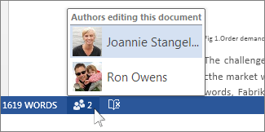

It was great for a lot of work…Really!
But as the number of reviewers and articles grew, eventually…

Slide 9
Every participant had to learn our tools to collaborate. That doesn’t scale.

Slide 10
Digression: The explosion of words
Community-written software demonstrated quality and scale
Speed of features increased radically
Huge new audiences sizes (Windows, Linux, Android, Mac, iOS)

Slide 11
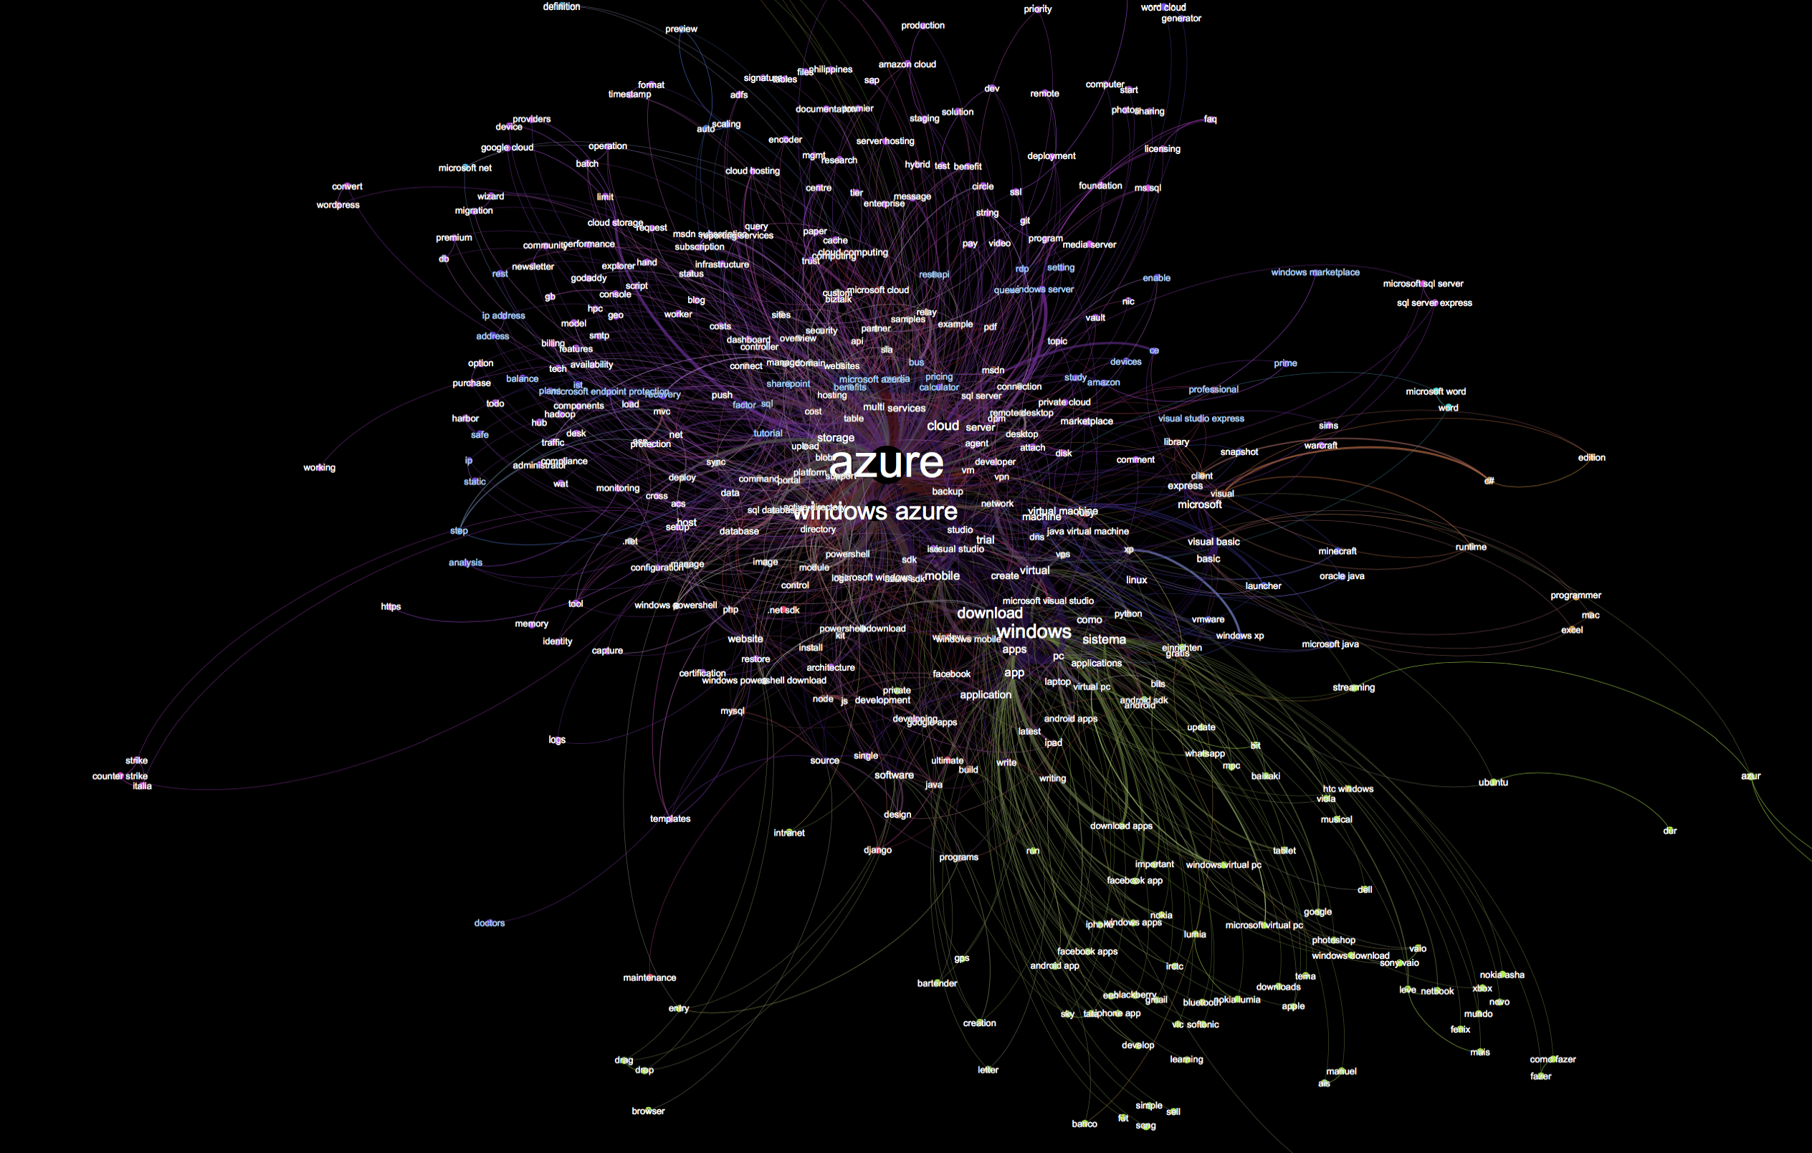

Slide 12
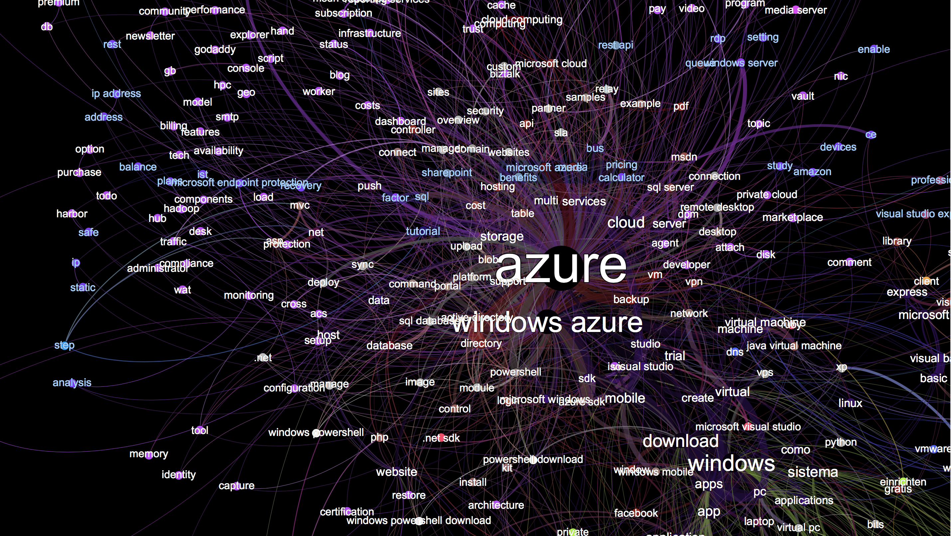

Slide 13
Expanding our world
Notes:
Take the best improvements in workflow and software and employ them better and faster. Change the way we worked, now.
ONLY open-source collaboration will work. Closed source collaboration, with the same tools, will never produce and manage enough to match the growth in customers for worldwide businesses. At scale, customers always know more and have more time and energy.
Top down commitment in large organizations is required; startups get to work differently.
Investment in automation is its own virtuous feedback loop.

Slide 14
Embrace the best and run harder
Internal data center and source-control ➔ https://github.com
Structured XML ➔ markdown
Custom Word-based authoring ➔ Anything that works with text
Windows-only ➔ anything that works with text
Automated validation ➔ different automated validation
Monthly freezes, builds ➔ instant staging, multiple daily publication
Professional writers ➔ Everyone’s a professional writer….

Slide 15
Collaboration is required to match the growth of words
PMs, development, support, and field own formal articles on azure.com
Use the platforms of our customers: Linux and Mac, not just Windows
Data-driven support items become documentation, not “support”
Write documentation now directly with customers and go live
Automation everywhere. EVERYWHERE. MORE. YESTERDAY.
Weekly freshness reviews keep content accurate
Professional writers ➔ Everyone’s a professional writer….

Slide 16
Drive the change from the top
Executive VP Scott Guthrie personally made it his mission
Hosted first two-day hackathon for documentation across all of Cloud and Enterprise: more than 500 people and all product groups in room
Regular “hackadocs” for smaller and more focused needs (freshness, style, metadata)
Hackadocs spreading across the company
Notes:
Anything to add here? Stats? Anecdotes we know?

Slide 17
Where we are
https://azure.com
Opensource:
Two repositories on https://github.com: public is https://github.com/azure/azure-content.
File format is markdown, with custom extensions for reuse, standardized javascript, and other special features.
Nothing in the entire toolchain is Windows-only
Authoring in anything that writes markdown.
Main topic 3: size 40pt
Size 20pt for the subtopics
Size 20pt for the subtopics

Slide 18

Who’s committing…
Of course, with dupicates and new accounts, it’s really on the order of about 900 contributions, in a normal distribution, as you’d expect….
3966 Sebastian Durandeu 2830 Molly Bostic 2105 v-aljenk 1891 Dene Hager 1739 Jim Becker 1621 Tyson Nevil 1527 Ross McAllister 1279 C.J. Gronlund 961 unknown 751 ggailey777 741 Ty 678 Tom Dykstra 673 Larry Franks 668 Sreedhar Pelluru 570 David Wrede 524 Jemash 512 Monica Rush 431 SharS 418 Glenn Gailey 416 Andy Pasic 387 pennij 383 Tom FitzMacken 360 CherylMc 351 Matt LaBelle 316 Ralph Squillace 312 Carolyn Gronlund 305 Kathy Davies 286 ShawnJackson 284 Bryan Lamos 279 Juliako 276 Walter Poupore (Microsoft) 273 Joao Madureira 272 jimbe 271 davidwrede 271 Tamra Myers 269 Alan Cameron Wills 265 cherylmc 264 Brian Swan 257 Jonathan Gao 242 Gary Ericson 236 HeidiSteen 236 Bill Mathers 235 Seth Manheim 230 Steve Stein 228 Andy (adegeo) 226 Jeff Stokes 224 Alpa Kohli 221 Dan Lepow 217 tysonn 217 Steve Danielson 217 Ryan Wike 209 Katie Griffith 207 Blackmist 206 Penni Johnson 190 v-kagri 188 cephalin 186 Matthew Henderson 185 Alma Jenks 183 deneha 182 Curtis Love 177 mimig 168 Sigrid Elenga 160 bradsev 157 pcw3187 157 Dhanashri Kshirsagar 155 Tom Archer 155 RickSaling 149 Jim-Parker 146 barbkess 144 Joost de Nijs 142 Patrick Sheahan 139 krisragh 139 Erik Reitan 138 sidneyh 136 ghogen 135 mattshel 135 GeneMi-MightyPen 131 jeffstokes72 130 Donna Malayeri 128 curtand 125 Bill Anderson 122 Telmo Sampaio 120 tfitzmac 119 Mimi Xu 117 Brian Wren 115 v-lincan 113 Stephen Siciliano 111 jessebenson 110 Ken Hoff 109 Christopher Anderson 108 Liza Poggemeyer 106 Jason Roth…..

Slide 19
Future plans

Slide 20
Our guiding principles…
Take the best improvements in workflow and software and employ them better and faster.
ONLY open-source collaboration will work. Why?
Closed source collaboration, with the same tools, does expand the knowledge base and supports more content, faster, but…
It will never match the growth in customers for worldwide businesses; in addition, it…
Prevents customer intelligence from being applied. At scale, customers always know more and have more time and energy.
Top down commitment in large organizations is required; startups get to work differently.
Investment in automation is its own virtuous feedback loop.

Slide 21

Dragons

Slide 22
DRAGON: Markdown is not structured.
Markdown is an easy way to type HTML quickly. That’s it.

Slide 23

We got this covered. No, really.
Notes:
Short version:
Markdown converts to xhtml, which IS structured.
Tools ecosystem for markdown and xhtml is massive.
Pandoc for conversion to mostly any other format.
Libraries in every language for everything.
Automation in all things.
Custom widgets validate markdown, prevent corruptions, implement custom transformations.
Every automation investment reduces downstream complaints, fixes, and increases comfort and scale.

Slide 24
DRAGON: Writers not familiar with markdown
Remember teaching them xmetal? Ooxml? DITA? HTML?

Slide 25

Markdown is vastly easier than XML.
Notes:
Short version:
Markdown was created to type HTML more easily. It works.
It requires no special tools or indenting or anything else to read easily compared to xml.

Slide 26
DRAGON: git and github
OK….. Um…

Slide 27

Still working on this one, but…
Notes:
Short version:
Extensive training required, because git is a source control system that does not really care about files, which writers think of as golden.
Developers use or understand git very quickly, so in software, that’s a plus….
Customers already use git, and can contribute without training, so we end up authoring in their comfort zone; they could never have contributed in our old comfort zone.

Slide 28
DRAGON: side effect of distributed authoring: merging does not scale out with community

Slide 29
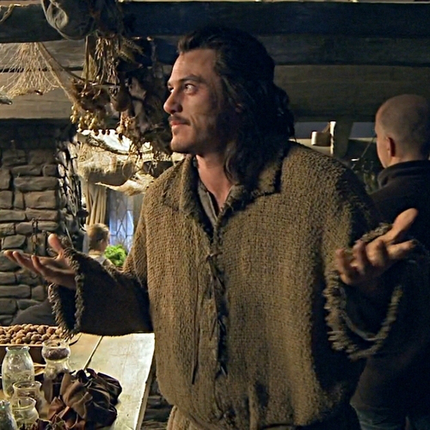
Oh, we got this one…
Notes:
Short version:
In the beginning the writers didn’t have enough knowledge of git to avoid mistakes, so had to get dedicated staff, but…
…even they could not handle the merge load without making mistakes, plus now contributors are committing all over the world, at all hours, so….
…automated validation removed 80% of contribution approvals, enabling smaller, more trained staff to focus on getting the files merged with higher confidence…
…and with more knowledge how to recover from mistakes.
Demo of do-not-merge tags? Validation?

